Slide 1
Wellness and Burnout in Academia: What faculty have experienced in academic medicine, how has it been affected by our current culture, and what do we do now?
Center for Faculty Excellence
Loyola University Chicago
3.22.24

Slide 2
Introductions
John Hardt, Ph.D.
Vice Dean, Professional Formation
Associate Professor, Bioethics
Stritch School of Medicine, Health Sciences Campus
Greg Ozark, M.D., F.A.A.P., F.A.C.P.
Professor Internal Medicine and Pediatrics
Vice President Graduate Medical Education, Loyola Medicine
Assistant Dean Graduate Medical Education, Loyola Stritch School of Medicine

Slide 3
For discussion
Provide some framework for understanding the issues of “burnout”.
Review specific elements and consequences of physician burnout.
Relate common elements in academic faculty burnout.
Consider common elements involved in wellness.
Identify wellness resources available to assist you as needed.

Slide 4
Understanding the issues of “burnout”
What are the symptoms ?
How can these symptoms progress?
What are the consequence of not addressing this issue?
How has our current [political/ post-pandemic] culture affected burnout.

Slide 5
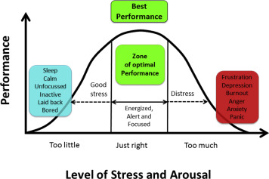
Understanding the issue: Stress is not burnout
Stress is not burnout.
Yerkes-Dodson Human Performance and Stress Curve

Slide 6
BURNOUT is…
Emotional exhaustion
feelings of being emotionally overextended and exhausted by one's work
Depersonalization
unfeeling and impersonal response toward recipients of one's service, care treatment, or instruction
Decreased feelings of personal accomplishment
lack of feelings of competence and successful achievement in one's work
Maslach, 1997

Slide 7
Physician “Burnout” Symptoms: regularly feeling as if you are…
Maslach definitions
(Physician) examples
Depersonalization
Decreased feelings of personal accomplishment
Emotional exhaustion
treating patients or coworkers as if they were impersonal objects
feeling emotionally drained from work
feeling dread upon waking knowing you have to face another day
being calloused/ insensitive to people
not caring what happens to your patients.
disliking working with you patients/ coworkers.
regretting your decision to enter medicine.

Slide 8
Development of Physician Burnout
The compulsion to prove oneself
Working harder
Neglecting needs
emotional, physical, educational
Displacement of conflicts
Revision of values
“I don’t have the time to deal with these things and they are not a priority.”
Denial of emerging problems
cynicism and aggression become more apparent
Ulrich, Scientific Mind: 2006

Slide 9
development of physician burnout
Withdrawal
become isolated and walled off
substance use
Odd behavioral changes
others in their immediate social circles can no longer overlook their behavioral changes
Depersonalization
life becomes a series of mechanical functions
Inner emptiness
recognition of “failure”
Depression
Burnout syndrome
Ulrich, Scientific Mind: 2006

Slide 10
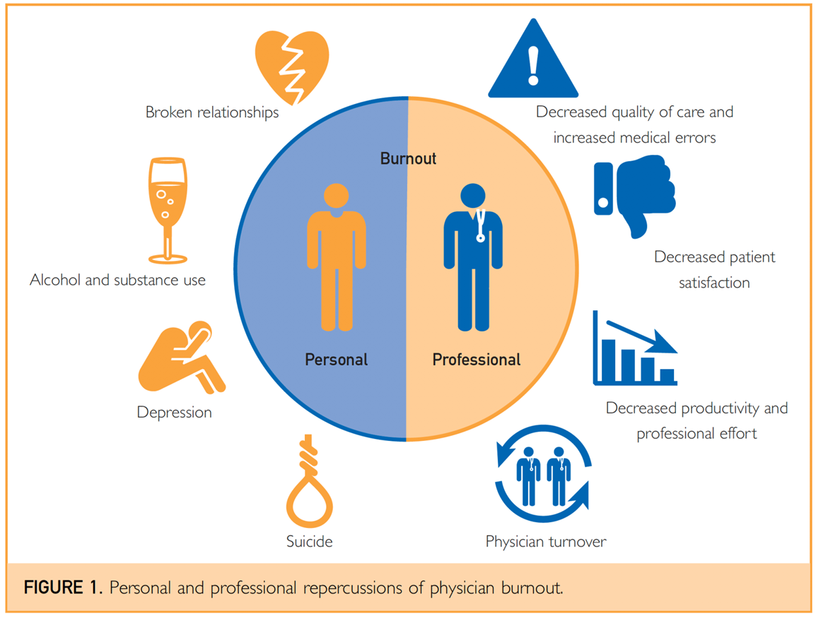
The danger of minimizing the word “burnout”
Shanafelt, Tait D. and John H. Noseworthy. “Executive Leadership and Physician Well‐being: Nine Organizational Strategies to Promote Engagement and Reduce Burnout.” Mayo Clinic Proceedings 92 (2017): 129–146.

Slide 11
Reality check! 50% of physicians are not “burned out”
But why is this such an issue in medicine?

Slide 12
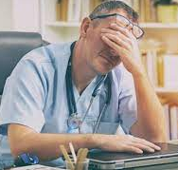
Why are physicians at such risk or burnout?
The Person
driven
goal directed
perfectionist
not self-forgiving
“M.D.” is what we are, not what we do
Trained to be independent and not ask for help
The Environment
productivity driven
cog in a wheel
24/7 access and demands
loss of control
inconsistency of outcomes
high stakes
competitive
One Outcome
frustration
antagonism
anxiety
demoralized
overwhelmed
guilt
imposter syndrome

Slide 13
the events of these past few years have not helped.
Damage to
self
sense of community
trust
support infrastructure
relationships
Loss of
control
autonomy
support
COVID
Racial injustice
Political unrest and incivility
Physician & healthcare mistrust
Social media

Slide 14
Academic BURNOUT
Emotional exhaustion (seems to start and dominate the process)
Increased work demands
Increased scrutiny
Increased time of administrative tasks
Depersonalization
Increased productivity & performance scrutiny
Increased administrator oversight
Decreased feelings of personal accomplishment
Decreased time allocated to personal academic endeavors
lack of feelings of competence and successful achievement in one's work
Sabagh, et al: Antecedents, correlates and consequences of faculty burnout. Educational Research, 2018 vol 60 no.2, 131-156

Slide 15
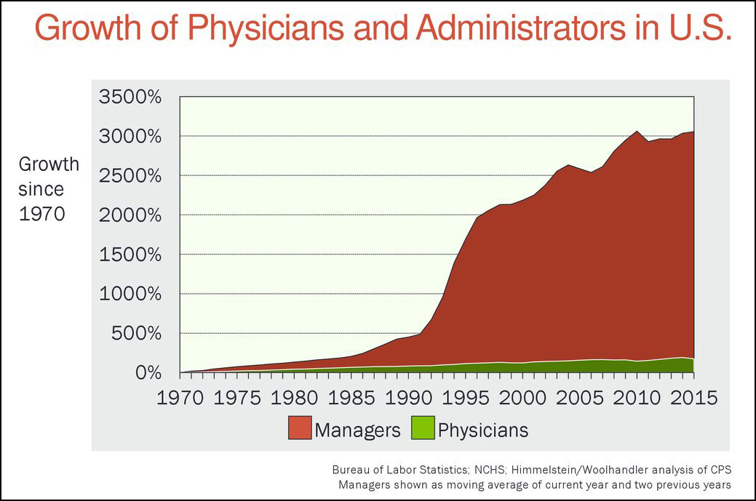
Common themes in professional Burnout
Decreased money and time
Cuts in tenure / tenured position and funding for academic pursuits
Increased productivity (teaching) targets and demands
Increased responsibilities and decreased autonomy
Increased oversight
Unclear workflow demands
Increased administrative burden
Faculty- administrative conflicts
Corporate culture
Sabagh, et al: Antecedents, correlates and consequences of faculty burnout. Educational Research, 2018 vol 60 no.2, 131-156

Slide 16
Outcomes of academic Burnout
Job attrition
Decreased work performance
Decreased work satisfaction
Isolation
Depression
Anxiety
Personal issues
Sabagh, et al: Antecedents, correlates and consequences of faculty burnout. Educational Research, 2018 vol 60 no.2, 131-156

Slide 17
John Hardt, PhD
Vice Dean, Professional Formation
Associate Professor, Bioethics
Stritch School of Medicine/ Health Sciences Campus

Slide 18
How can we address these issues at an Institutional and individual level?
Accept this issue is real.
Accept being at risk.
Address some basics in being “well”
Know who is in your corner and how to reach them.
Realize your ability to enact changes needed.
Personnel level
Leadership level

Slide 19
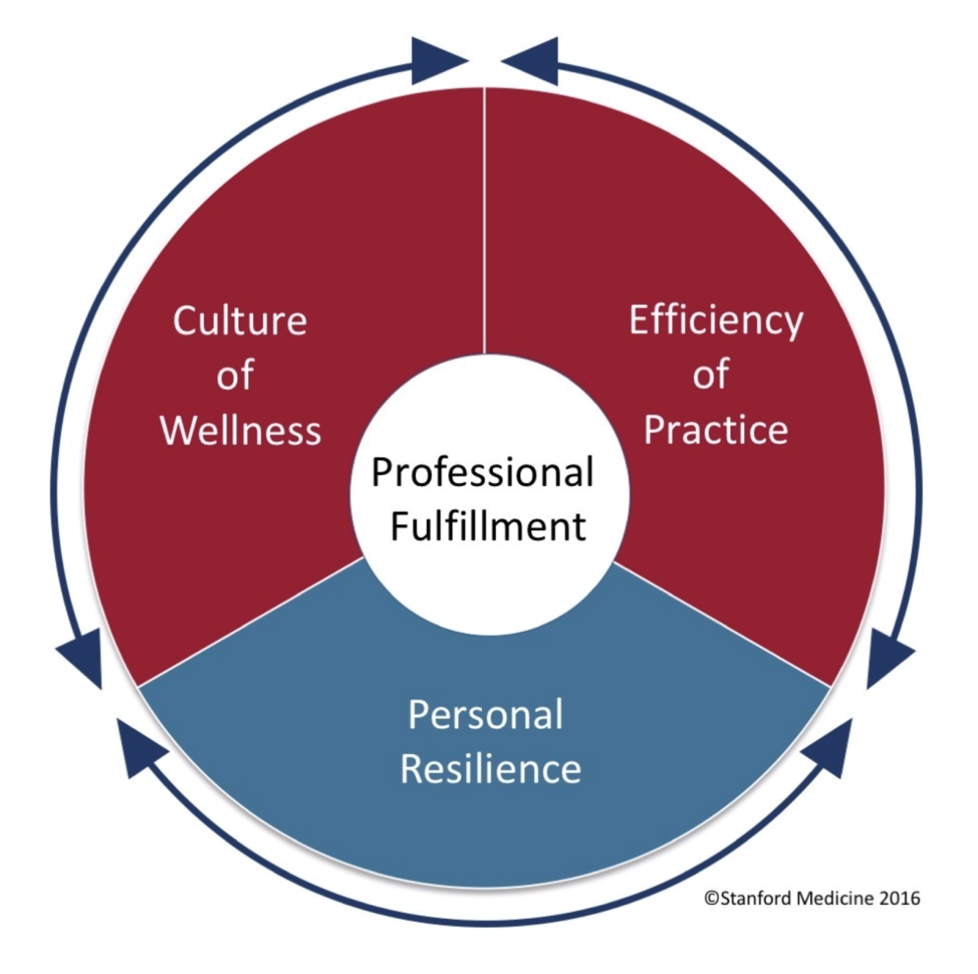
Trockel, Mickey, Maryam Hamidi, Mary Lou Murphy, Patty Purpur de Vries, and Bryan Bohman. "2016 Physician Wellness Survey Full Report." (2017).

Slide 20
The road to Professional Fulfillment: Culture of Wellness
General:
Needs to take the 1st step
Organizational goals and values that promote personal and professional growth, compassion
Regular measurement of wellness, professional satisfaction
Culture of Appreciation
Transparency
Mentors
Trockel, Mickey, Maryam Hamidi, Mary Lou Murphy, Patty Purpur de Vries, and Bryan Bohman. "2016 Physician Wellness Survey Full Report." (2017).

Slide 21
The road to Professional Fulfillment: Efficiency of Practice
General:
Systems that promote effectiveness, safety and work-life balance
Streamline EMR and IT
Involve physicians in redesign of clinical processes
Realistic staffing models
Schedule control
Practice specific
Trockel, Mickey, Maryam Hamidi, Mary Lou Murphy, Patty Purpur de Vries, and Bryan Bohman. "2016 Physician Wellness Survey Full Report." (2017).

Slide 22
The road to Professional Fulfillment Personal Resilience
General:
No one “size fits all”
Some commonalities exist
Can be a difficult conversation

Slide 23
Physician Wellness
Psychological self-care: faith/ spiritual practices, relationships, education, financial order and plan
Balance: educational, personal, vocational
Involvement and engagement in community, education, work.
mindfulness of practice, reflection, creating boundaries
Physical Self-care: healthy diet, regular exercise, sleep schedule, healthy lifestyle
Maintaining personal interests: vacations/ retreats/ friends/ family/ research/ hobbies
Developing balance takes time and commitment
It is not a one-time investment
Time at the top is transient
You will need to adjust
You will struggle
It DOES pay off!!!

Slide 24
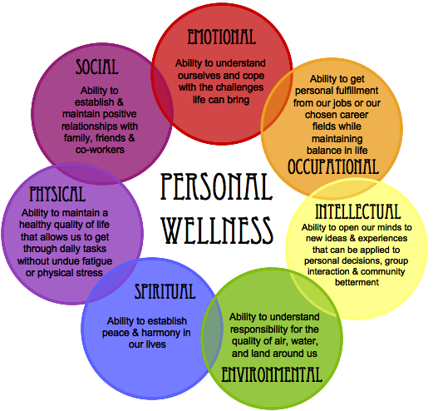
There is no “one size fits all” fix
Shared responsibility
Individual
Organization
Common themes
Lots of individual variances
Increasing community, engagement, and mission

Slide 25
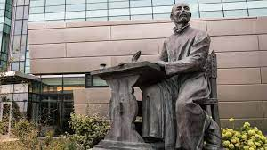
practice Principles of Wellness and Burnout Prevention
Humanism
Mindfulness
Reflection

Slide 26
Humanism
Taking time to connect with each person.
slowing down, being in the moment (understanding importance of each interaction)
Trainees
Co-worker
Self
Habits to Sustain Humanism
Self- Reflection and Evaluation
Man, I was a jerk today… I need to apologize
Hey, I did a good job today!
Maintaining balance
Establishing boundaries

Slide 27
Mindfulness
The practice of paying attention in the present with intention and without judgment.
Allows awareness of the present
Helps to orient a person to their triggers
focus on positive experiences/ energies
dismiss negative experiences/ energies

Slide 28
reflection
Try to remember the importance of what you do EVERYDAY though it may seem routine.
Remember the patient/ person at the other end of the encounter.
See Humanity (Divinity) in all you encounter
Including yourself
Illegitimi non carborundum

Slide 29
Wellness resources
Center for Faculty Excellence
Loyola University Chicago

Slide 30
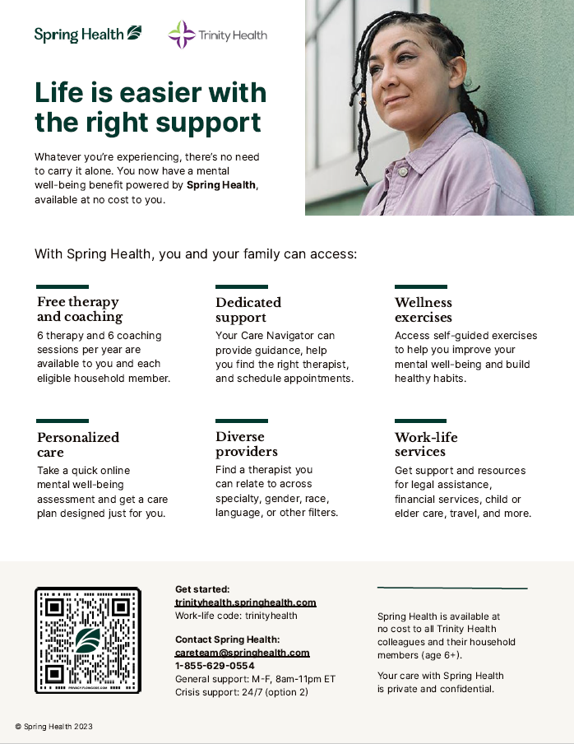
Trinity Health Resources: individual- Employee Assistance Program
Spring Health
Get Started
www.trinityhealth.springhealth.com
Work-life code: trinityhealth
Contact Spring Health
careteam@springhealth.com
1-855-629-0554
Confidential/ Free

Slide 31
SSOM Resources: individual- Employee Assistance Program
Perspectives Counseling Service:
Username: LUC500-password: perspectives
https://ssom.luc.edu/wellness/counseling/
24/7 Telephone Number: 1-800-456-6327
Onsite Location: Cuneo Building, Room 180
Wellness Center: Loyola University Chicago (luc.edu)
24/7 Crisis/ Suicide Prevention Hotline
ALSO: 988 is the National Suicide Prevention Hotline
Resource for
Child Care , Elder Care, Pet Care
Finances
Stress/ Depression/ Substance abuse
Individual support

Slide 32
Other Institutional Resources
Program/ departmental resources
Care for the Caregiver
Physician resiliency coaches
Spiritual Care
Loyola: 708-216-9056
Personal physician

Slide 33
Wellness pitfalls
This will not happen to me.
There’s nothing I can do about it.
Over personalization of daily stress/ conflict.
So, you’re telling me I'm broken and I need to fix myself?
The wellness “cool-aid” they want me to drink is dumb. (e.g. Yoga is not going to make we well!)
It’s up to the institution to fix me.
If I had more (money, perks, titles, recognition, publications…) I would be happy.
I am too far gone to be helped.
No one can help me.

Slide 34
What we sometimes forget
Everyone does go thru this.
You are valued.
The tribulations of our lives and work are not (usually) a personal attack against you.
You are amazingly gifted to help others who need us at the most desperate time of their lives.
People do want to help you.

Slide 35
discussion
What are your responses when someone starts bringing up "wellness"?
What are some words that describe the last few years?
What are some tips you use to work on your own wellness?
How do you hope to feel if you were at your most well?
Does anyone want to share a tip they have learned to get out of a bad time?
Given the constraints of medical training how can we improve on physician wellness at Loyola? (i.e. what works and what does not?)

Slide 36
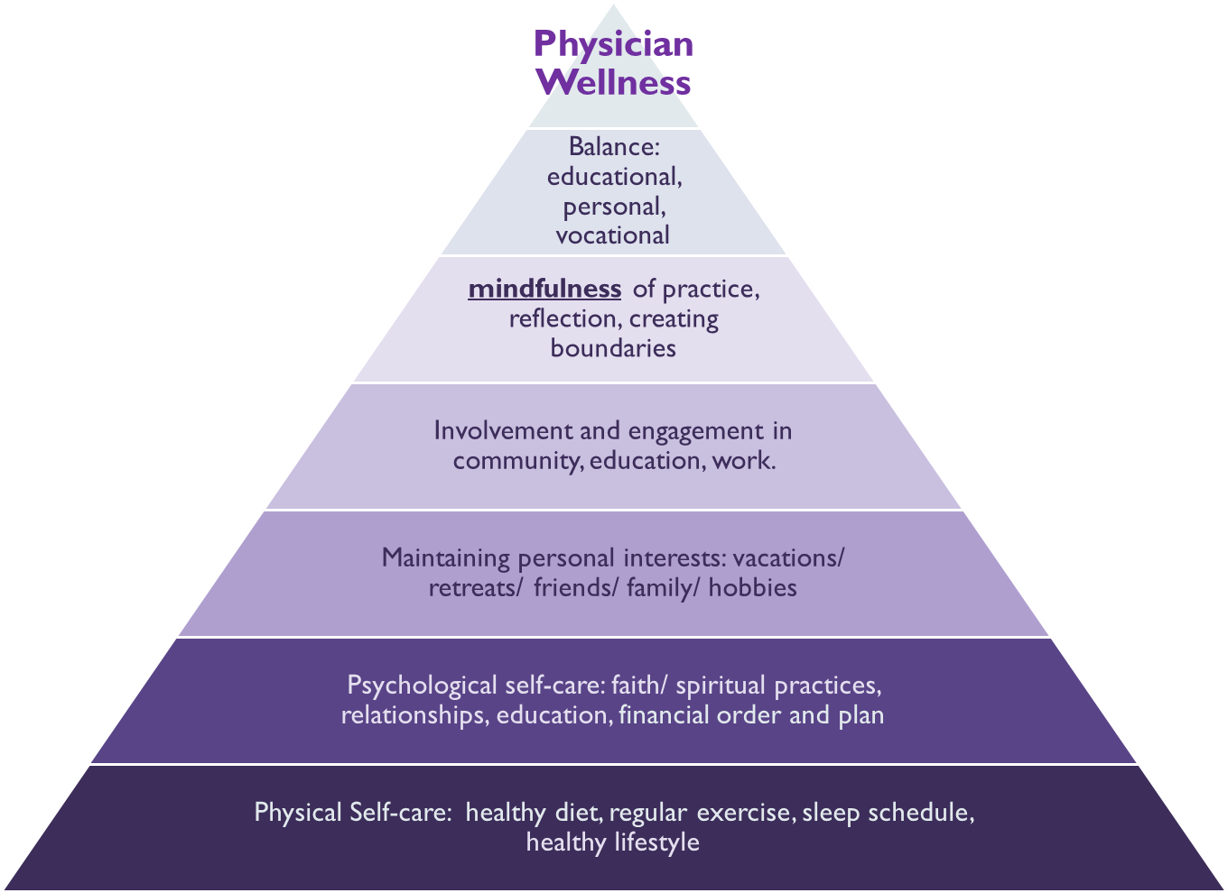
Working thru the problem: supporting one another
Watch for the warning signs
Isolation
Anger
Personality changes
Tardiness/ increased absenteeism
Don’t be afraid to reach out and ask: “are you ok?”
Connect with one another
Use your resources

Slide 37
Our Institutional and professional Commitment to one another
We will
utilize our resources to care for and respect our patients and one another.
listen to each other.
work to support and help one another.
use our talents to work thru this and emerge smarter and stronger.
This is our mission and commitment as physicians.

Slide 38
Thank you for attending

